Slide 1

yummy yummy

Slide 2
COLOUR PALETTE
6.2
Passes AA level for any size text and AAA for large text (above 18pt or bold above 14pt)
10.7
Passes AAA level for any size text
Main background colour
RGB: 88, 43, 1
Hex: #582b01
Highlight colour
RGB: 227, 181, 60
Hex: #e3b53c
Main text colour
RGB: 242, 242, 242
Hex: #f2f2f2
This colour has a high contrast ratio with the other two colours chosen, therefore will be best as the background. It is also present in the logo and will give the app an earthy feel, subconsciously making the user believe the business is environmentally friendly.
This colour has a contrast ratio of 6.2 with the background, so is less suitable as the main text colour. It will be used for buttons and highlighted text to ensure that it is only used at a readable size. Orange is associated with joy and creativity, which will make the customers have faith in our brand before even entering a store. It is also a bright colour, which will draw the user’s eye to important areas.
This colour has a contrast ratio of 10.7 with the background, so is very well suited as the main text colour. The colour is slightly off white (approaching silver), which is used by major online brands such as Facebook, Twitter and JustEat. These companies use it as the background colour, with a slightly off black as the text colour, however as we have a dark background we will have to use the inverse. If major companies are using it then it must be a good choice!

Slide 3
INVERSE COLOUR PALETTE
6.2
Passes AA level for any size text and AAA for large text (above 18pt or bold above 14pt)
Inverse background colour
RGB: 227, 181, 60
Hex: #e3b53c
Inverse text colour
RGB: 88, 43, 1
Hex: #582b01
These colours are the highlight and background colours from the main colour scheme. They work well with each other in the main colour scheme, so it makes sense to use them both together whenever an inverse scheme is required. This will be used mainly for buttons, although the start screen within the app will also use this inverse colour palette.

Slide 4
TYPOGRAPHY
MAIN HEADER TEXT
Albertus Medium, 44px. Text will be bold, in all caps and use the highlight colour so it stands out in multiple locales. Text will use the font from the logo
subtitle text
Albertus Medium, 36px. Text will be in italics and all lower case
Normal text
- Albertus Medium, 18px. Text will be without modifiers.

Slide 5
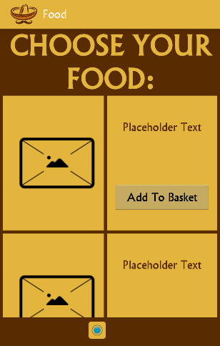
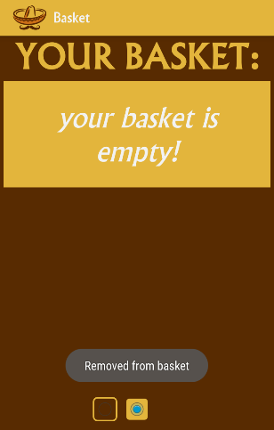
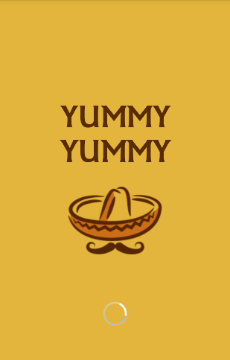
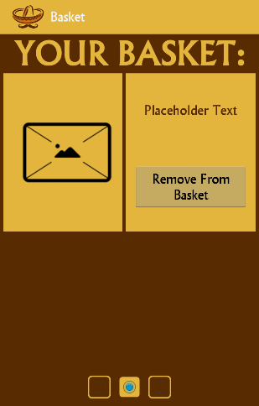
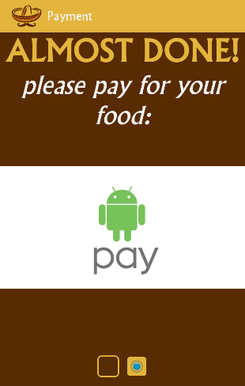
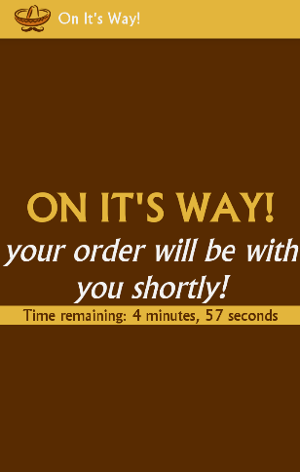
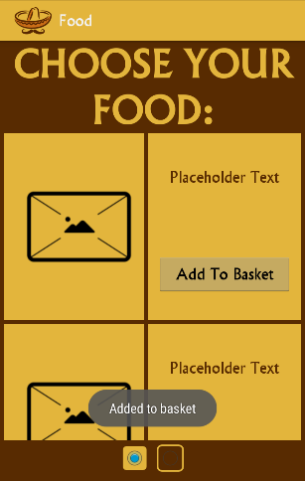
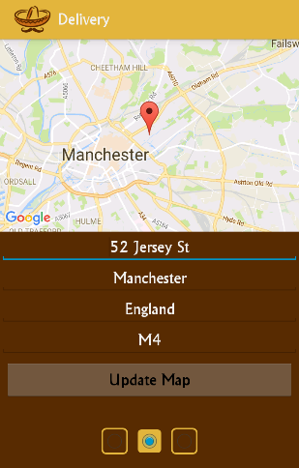
STORYBOARD
List of available food
Item removed from basket
Display countdown to delivery
Splash screen
Payment screen
Items in basket
Item added to basket
Select delivery address

Slide 6
ACCESSIBILITY
In order to make the design accessible, a clear font is used. This font is themed towards our brand whilst still being visible to people with vision impairments.
The colour palettes all have high contrast ratios – this means that it will be easier for colourblind people to read the text.
The font sizes are all 18px or above, meaning they all meet AAA ratings for Web Content Accessibility Guidelines 2.0.
There are two differences between each style of font (colour, weight, size). This means that hierarchy will be understood in languages that do not change for one of the modifiers.

Slide 7
HEURISTIC PRINCIPLES
Memory – the app is split into chunks (or screens) so that related content is kept close together. In addition to this, different background colours are used to show related content (e.g. basket items). These chunks help the user to quickly skim the content, and the use of varying font styles are used to help the user quickly summarise the content.
Perception – this is tied into the chunking. There is clear contrast between the MAIN HEADER TEXT, subtitle text and normal text. This allows the user to quickly and correctly perceive the text shown.
Error prevention – the user is prevented from moving on to certain screens before they have entered required data, which prevents a chance of an error occurring further down the line, when the app realises it needs data it doesn’t have.
Aesthetic/minimalist design – the theme is consistent throughout the screens, but only information needed for that specific step is required, keeping the design minimalistic.

Slide 8
PREDICTIVE PRINCIPLES
Fitt’s law – this states that the larger and closer a target, the faster a user will be able to hit it. I have taken this into account by using slightly larger font sizes, which in turn means that the text entry fields and buttons will also be slightly larger than usual.
Hick’s law – this states that if a user has more choices, it will take them longer to arrive at a decision. By taking this into account I have reduced the amount of choices a user has to make, with the only real decisions being what items to include in their basket. I have also kept all the screens simple, further reducing the amount of time required to process the choices.
Navigation is kept consistent between the majority of the screens – this makes it easier for the user as they do not have to figure out how to move on to the next step. In addition to this, the navigation principle is similar to many others used. This makes it easier for the user to instantly know what to do.
GOMS – All the methods of data input have been made as simple as possible. For example, the user can select a point on a Google Map and it will get their address, instead of them having to type it in manually (although this is still available, to cater to all users).
Throughput – This all depends on the speed of the mobile device. Most of the commands can operate instantly, however on some older devices it can take longer to render the Google Map. In these circumstances, a loading spinner should be displayed so the user knows the current system status (one of Nielsen’s 10 Heuristic Principles).

Slide 9
DESCRIPTIVE PRINCIPLES
Key-action Model – some screens require more information before the user can progress. In these cases, a navigation button is hidden until the user has entered the required data. This ties in with the Error Prevention Heuristic Principle, as the application will fail if it reaches a later stage without all the required information.
Guiard’s model of bimanual skill – this relates to the role of hands in two-handed interaction, for example the preferred hand (typically right if you are right handed and left if you are left handed) is used for more precise details whereas the non-preferred hand is less accurate and so can only be used for more general actions

Slide 10
EVALUATION
This application solves the issue well, although there are a couple of issues:
- Short term memory – to make it easier for the user, having a “last order” button would streamline the process and overall increase performance. This would also satisfy one of Nielsen’s 10 Heuristic Principles.
- Performance on different devices – to make the app more accessible, the performance hit taken whilst attempting to load a Google Map should be reduced (or replaced with something else). This is to prevent users cancelling due to the app hanging.

Slide 11
SOURCES
Colour contrast ratios measured with http://leaverou.github.io/contrast-ratio
Logo designed with https://www.freelogoservices.com
App designed using Android Studio and rendered on Motorola Moto G, running Android Lollipop 5.1

